Slide 1

Cryptography and Network Security
Chapter 2
William Stallings
Notes:
Lecture slides by Lawrie Brown for “Cryptography and Network Security”, 5/e, by William Stallings, Chapter 2 – “Classical Encryption Techniques”.

Slide 2
Chapter 2 – Classical Encryption
Techniques
"I am fairly familiar with all the forms of secret writings, and am myself the author of a trifling monograph upon the subject, in which I analyze one hundred and sixty separate ciphers," said Holmes..
—The Adventure of the Dancing Men, Sir Arthur Conan Doyle
Notes:
Opening quote.

Slide 3
Symmetric Encryption
or conventional / private-key / single-key
sender and recipient share a common key
all classical encryption algorithms are private-key
was only type prior to invention of public-key in 1970’s
and by far most widely used
Notes:
Symmetric encryption, also referred to as conventional encryption or single-key encryption, was the only type of encryption in use prior to the development of public-key encryption in the 1970s. It remains by far the most widely used of the two types of encryption. All traditional schemes are symmetric / single key / private-key encryption algorithms, with a single key, used for both encryption and decryption. Since both sender and receiver are equivalent, either can encrypt or decrypt messages using that common key.

Slide 4
Some Basic Terminology
plaintext - original message
ciphertext - coded message
cipher - algorithm for transforming plaintext to ciphertext
key - info used in cipher known only to sender/receiver
encipher (encrypt) - converting plaintext to ciphertext
decipher (decrypt) - recovering ciphertext from plaintext
cryptography - study of encryption principles/methods
-Types of operation used for transforming plaintext to ciphetext
-Number of keys used
-Way in which plain text is processed
cryptanalysis (codebreaking) - study of principles/ methods of deciphering ciphertext without knowing key
cryptology - field of both cryptography and cryptanalysis
Notes:
Briefly review some terminology used throughout the course.

Slide 5
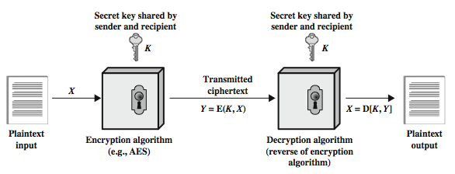
Symmetric Cipher Model
Notes:
Detail the five ingredients of the symmetric cipher model, shown in Stallings Figure 2.1:
plaintext - original message
encryption algorithm – performs substitutions/transformations on plaintext
secret key – control exact substitutions/transformations used in encryption algorithm
ciphertext - scrambled message
decryption algorithm – inverse of encryption algorithm

Slide 6
Requirements
two requirements for secure use of symmetric encryption:
  a strong encryption algorithm
  a secret key known only to sender / receiver
mathematically have:
  Y = E(K, X)
  X = D(K, Y)
assume encryption algorithm is known
implies a secure channel to distribute key
Notes:
There are two requirements for secure use of conventional encryption that mean we assume that it is impractical to decrypt a message on the basis of the cipher- text plus knowledge of the encryption/decryption algorithm, and hence do not need to keep the algorithm secret; rather we only need to keep the key secret. This feature of symmetric encryption is what makes it feasible for widespread use. It allows easy distribution of s/w and h/w implementations.
Can take a closer look at the essential elements of a symmetric encryption scheme: mathematically it can be considered a pair of functions with: plaintext X, ciphertext Y, key K, encryption algorithm E, decryption algorithm D. The intended receiver, in possession of the key, is able to invert the transformation. An opponent, observing Y but not having access to K or X, may attempt to recover X or K.

Slide 7
Cryptography
can characterize cryptographic system by:
  type of encryption operations used
    substitution
    transposition
    product
  number of keys used
    single-key or private
    two-key or public
  way in which plaintext is processed
  stream cipher is one that encrypts a digital data stream one bit or one byte at a time.
block cipher is one in which a block of plaintext is treated as a whole and used to produce a ciphertext block of equal length. Typically, a block size of 64 or128 bits is used.
Notes:
Cryptographic systems can be characterized along these three independent dimensions.
The type of operations used for transforming plaintext to ciphertext. All encryption algorithms are based on two general principles: substitution, in which each element in the plaintext (bit, letter, group of bits or letters) is mapped into another element, and transposition, in which elements in the plaintext are rearranged. The fundamental requirement is that no information be lost (that is, that all operations are reversible). Most systems, referred to as product systems, involve multiple stages of substitutions and transpositions.
The number of keys used. If both sender and receiver use the same key, the system is referred to as symmetric, single-key, secret-key, or conventional encryption. If the sender and receiver use different keys, the system is referred to as asymmetric, two-key, or public-key encryption.
The way in which the plaintext is processed. A block cipher processes the input one block of elements at a time, producing an output block for each input block. A stream cipher processes the input elements continuously, producing output one element at a time, as it goes along.

Slide 8
Cryptanalysis
objective to recover key not just message
general approaches:
  cryptanalytic attack
  brute-force attack
if either succeed all key use compromised
Notes:
Typically objective is to recover the key in use rather then simply to recover the plaintext of a single ciphertext. There are two general approaches:
Cryptanalysis: relies on the nature of the algorithm plus perhaps some knowledge of the general characteristics of the plaintext or even some sample plaintext- ciphertext pairs. This type of attack exploits the characteristics of the algorithm to attempt to deduce a specific plaintext or to deduce the key being used.
Brute-force attacks try every possible key on a piece of ciphertext until an intelligible translation into plaintext is obtained. On average,half of all possible keys must be tried to achieve success.
If either type of attack succeeds in deducing the key, the effect is catastrophic: All future and past messages encrypted with that key are compromised.

Slide 9
Cryptanalytic Attacks
ciphertext only
  only know algorithm & ciphertext, is statistical, know or can identify plaintext
known plaintext
  know/suspect plaintext & ciphertext
chosen plaintext
  select plaintext and obtain ciphertext
chosen ciphertext
  select ciphertext and obtain plaintext
chosen text
  select plaintext or ciphertext to en/decrypt
Notes:
Stallings Table 2.1 summarizes the various types of cryptanalytic attacks, based on the amount of information known to the cryptanalyst, from least to most. The most difficult problem is presented when all that is available is the ciphertext only. In some cases, not even the encryption algorithm is known, but in general we can assume that the opponent does know the algorithm used for encryption. Then with increasing information have the other attacks. Generally, an encryption algorithm is designed to withstand a known-plaintext attack.

Slide 10
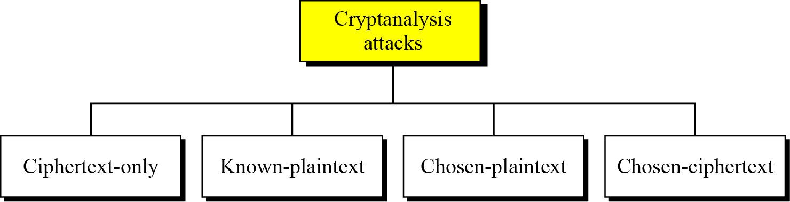
3.1.2 Cryptanalysis
As cryptography is the science and art of creating secret codes, cryptanalysis is the science and art of breaking those codes.
Figure 3.3 Cryptanalysis attacks
3.<number>

Slide 11
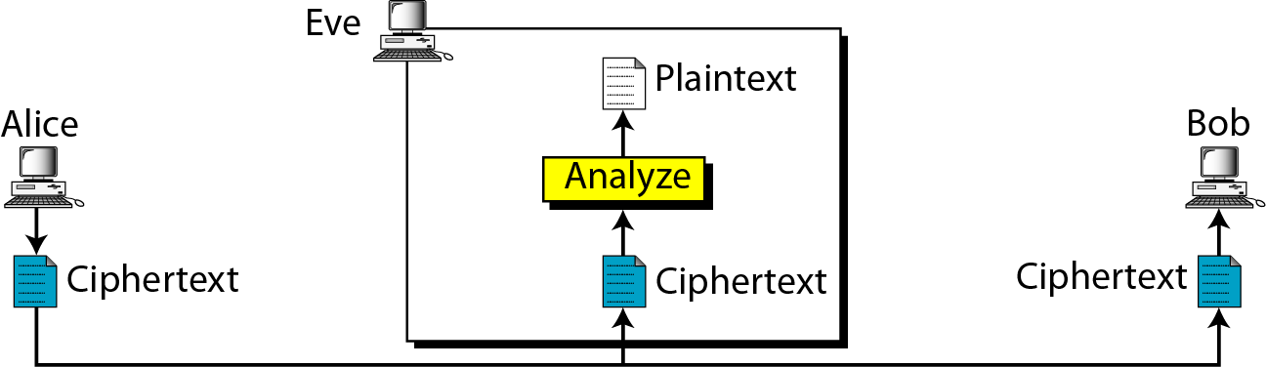
3.1.2 Continued
Ciphertext-Only Attack
Figure 3.4 Ciphertext-only attack
3.<number>

Slide 12
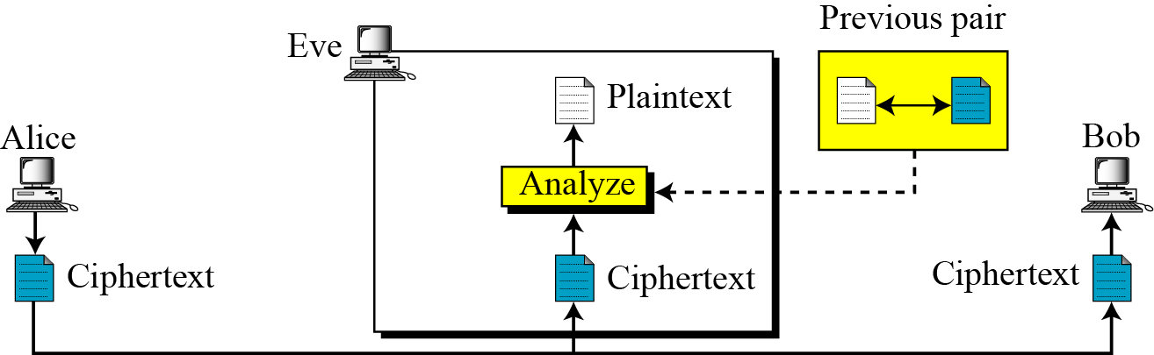
3.1.2 Continued
Known-Plaintext Attack
Figure 3.5 Known-plaintext attack
3.<number>

Slide 13
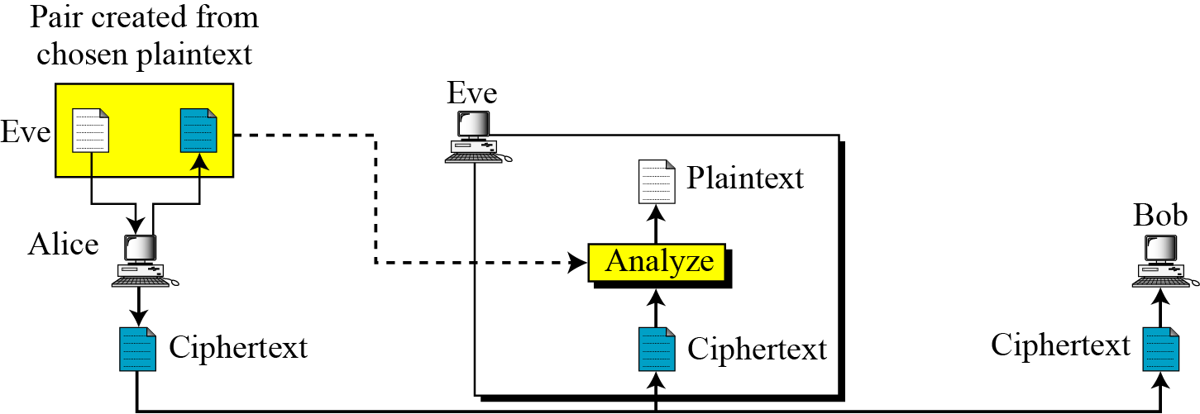
3.1.2 Continued
Chosen-Plaintext Attack
Figure 3.6 Chosen-plaintext attack
3.<number>

Slide 14
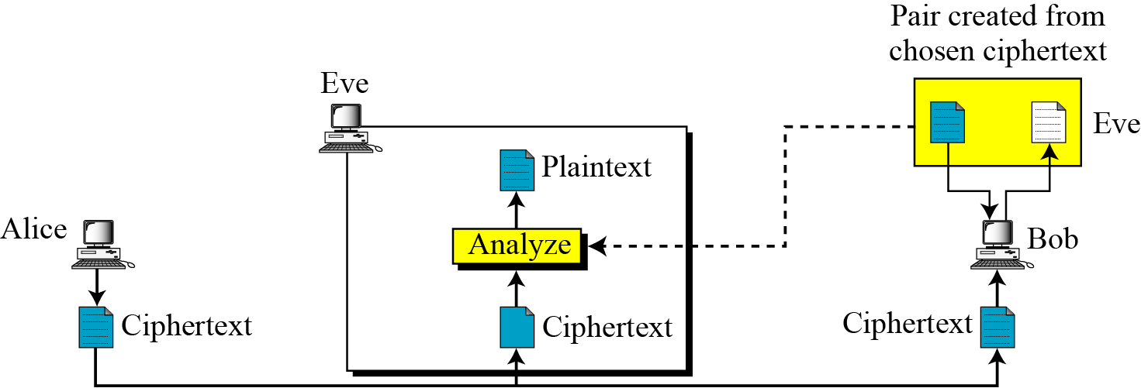
3.1.2 Continued
Chosen-Ciphertext Attack
Figure 3.7 Chosen-ciphertext attack
3.<number>

Slide 15
Classical Substitution Ciphers
where letters of plaintext are replaced by other letters or by numbers or symbols
or if plaintext is viewed as a sequence of bits, then substitution involves replacing plaintext bit patterns with ciphertext bit patterns
Notes:
In this section and the next, we examine a sampling of what might be called classical encryption techniques. A study of these techniques enables us to illustrate the basic approaches to symmetric encryption used today and the types of cryptanalytic attacks that must be anticipated. The two basic building blocks of all encryption technique are substitution and transposition. We examine these in the next two sections. Finally, we discuss a system that combine both substitution and transposition.
A substitution technique is one in which the letters of plaintext are replaced by other letters or by numbers or symbols. If the plaintext is viewed as a sequence of bits, then substitution involves replacing plaintext bit patterns with ciphertext bit patterns.

Slide 16
Caesar Cipher
earliest known substitution cipher
by Julius Caesar
first attested use in military affairs
replaces each letter by 3rd letter on
example:
  meet me after the toga party
  PHHW PH DIWHU WKH WRJD SDUWB
Notes:
Substitution ciphers form the first of the fundamental building blocks. The core idea is to replace one basic unit (letter/byte) with another. Whilst the early Greeks described several substitution ciphers, the first attested use in military affairs of one was by Julius Caesar, described by him in Gallic Wars (cf. Kahn pp83-84). Still call any cipher using a simple letter shift a caesar cipher, not just those with shift 3.

Slide 17
Caesar Cipher
can define transformation as:
  a b c d e f g h i j k l m n o p q r s t u v w x y z
  D E F G H I J K L M N O P Q R S T U V W X Y Z A B C
mathematically give each letter a number
  a b c d e f g h i j k l m n o p q r s t u v w x y z
  0 1 2 3 4 5 6 7 8 9 10 11 12 13 14 15 16 17 18 19 20 21 22 23 24 25
then have Caesar cipher as:
  c = E(k, p) = (p + k) mod (26)
  p = D(k, c) = (c – k) mod (26)
Notes:
This mathematical description uses modulo (clock) arithmetic. Here, when you reach Z you go back to A and start again. Mod 26 implies that when you reach 26, you use 0 instead (ie the letter after Z, or 25 + 1 goes to A or 0).
Example: howdy (7,14,22,3,24) encrypted using key f (ie a shift of 5) is MTBID

Slide 18
Cryptanalysis of Caesar Cipher
only have 26 possible ciphers
  A maps to A,B,..Z
could simply try each in turn
a brute force search
given ciphertext, just try all shifts of letters
do need to recognize when have plaintext
eg. break ciphertext "GCUA VQ DTGCM"
Notes:
With a caesar cipher, there are only 26 possible keys, of which only 25 are of any use, since mapping A to A etc doesn't really obscure the message! Note this basic rule of cryptanalysis "check to ensure the cipher operator hasn't goofed and sent a plaintext message by mistake"!
Can try each of the keys (shifts) in turn, until can recognise the original message. See Stallings Fig 2.3 for example of search.
Note: as mentioned before, do need to be able to recognise when have an original message (ie is it English or whatever). Usually easy for humans, hard for computers. Though if using say compressed data could be much harder.
Example "GCUA VQ DTGCM" when broken gives "easy to break", with a shift of 2 (key C).

Slide 19
Monoalphabetic Cipher
rather than just shifting the alphabet
could shuffle (jumble) the letters arbitrarily
each plaintext letter maps to a different random ciphertext letter
hence key is 26 letters long
  Plain: abcdefghijklmnopqrstuvwxyz
  Cipher: DKVQFIBJWPESCXHTMYAUOLRGZN
  Plaintext: ifwewishtoreplaceletters
  Ciphertext: WIRFRWAJUHYFTSDVFSFUUFYA
Notes:
With only 25 possible keys, the Caesar cipher is far from secure. A dramatic increase in the key space can be achieved by allowing an arbitrary substitution, where the translation alphabet can be any permutation of the 26 alphabetic characters. A permutation of a finite set of elements S is an ordered sequence of all the elements of S, with each element appearing exactly once. In general, there are n! permutations of a set of n elements.
See text example of a translation alphabet, and an encrypted message using it.

Slide 20
Monoalphabetic Cipher Security
now have a total of 26! = 4 x 10²⁶ keys
with so many keys, might think is secure
but would be !!!WRONG!!!
problem is language characteristics
Notes:
Note that even given the very large number of keys, being 10 orders of magnitude greater than the key space for DES, the monoalphabetic substitution cipher is not secure, because it does not sufficiently obscure the underlying language characteristics.

Slide 21
Language Redundancy and Cryptanalysis
human languages are redundant
eg "th lrd s m shphrd shll nt wnt"
letters are not equally commonly used
in English E is by far the most common letter
  followed by T,R,N,I,O,A,S
other letters like Z,J,K,Q,X are fairly rare
have tables of single, double & triple letter frequencies for various languages
Notes:
As the example shows, we don't actually need all the letters in order to understand written English text. Here vowels were removed, but they're not the only redundancy. cf written Hebrew has no vowels for same reason. Are usually familiar with "party conversations", can hear one person speaking out of hubbub of many, again because of redundancy in aural language also. This redundancy is also the reason we can compress text files, the computer can derive a more compact encoding without losing any information. Basic idea is to count the relative frequencies of letters, and note the resulting pattern.

Slide 22
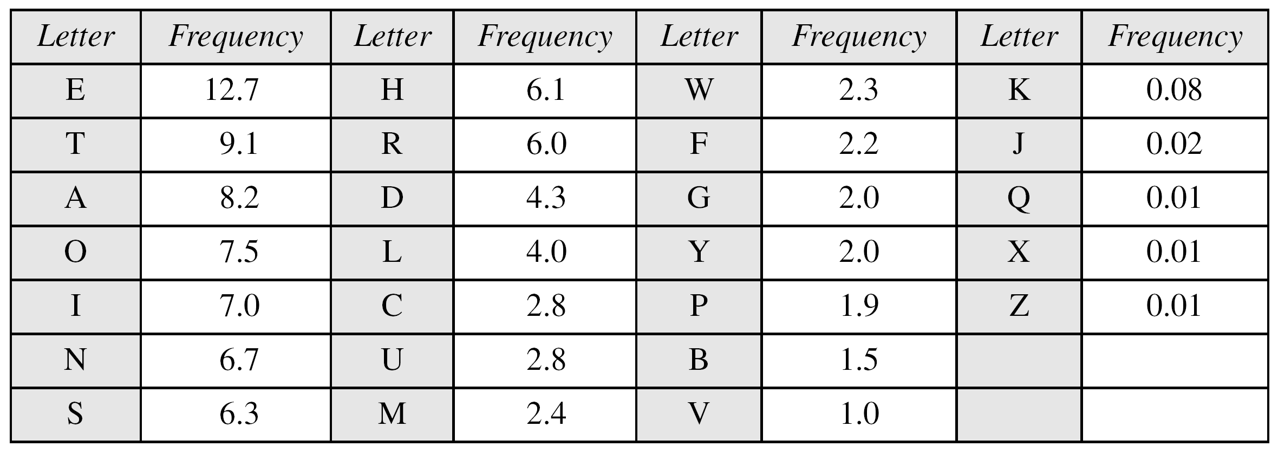
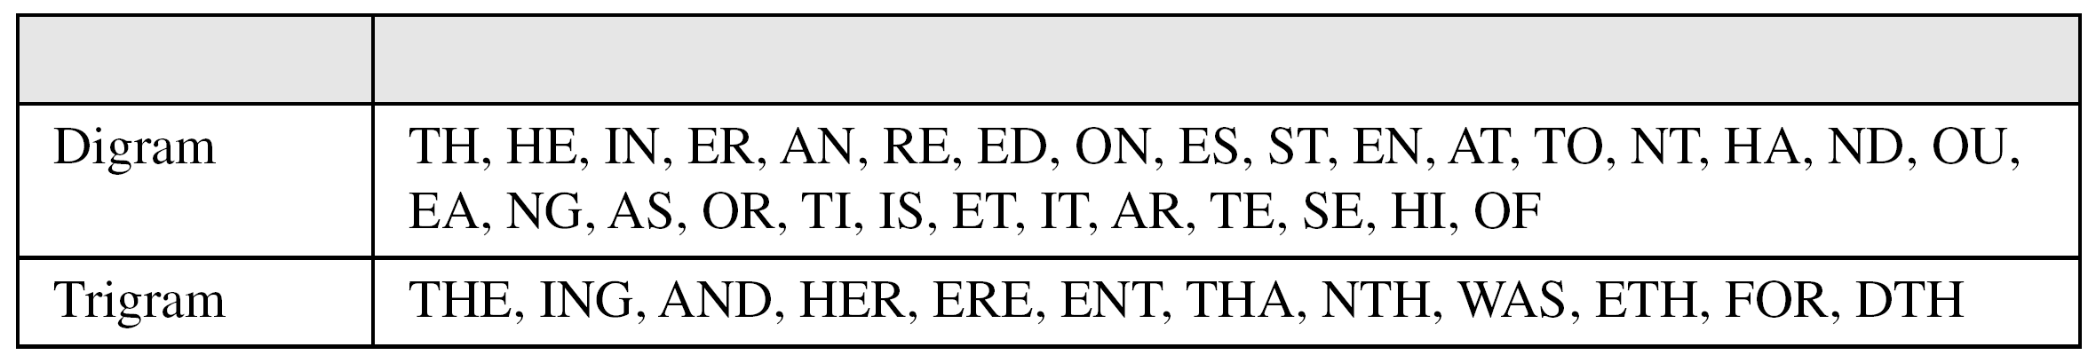
3.2.1 Continued
Table 3.1 Frequency of characters in English
Table 3.2 Frequency of diagrams and trigrams
3.<number>

Slide 23
3.2.1 Continued
Example 3.6
Eve has intercepted the following ciphertext. Using a statistical attack, find the plaintext.
Solution
When Eve tabulates the frequency of letters in this ciphertext, she gets: I =14, V =13, S =12, and so on. The most common character is I with 14 occurrences. This means key = 4.
3.<number>

Slide 24
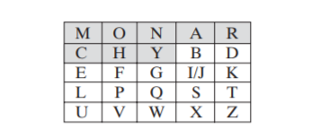
Playfair Cipher
In this case, the keyword is monarchy.
The matrix is constructed by filling in the letters of the keyword (minus duplicates) from left to right and from top to bottom, and then filling in the remainder of the matrix with the remaining letters in alphabetic order.
The letters I and J count as one at a time, according to the following letter. Plaintext is encrypted two letters wing rules:
3.<number>

Slide 25
OFF-- OF FX
GREET—GR EX ET
1. Repeating plaintext letters that are in the same pair are separated with a filler letter, such as x, so that balloon would be treated as ba lx lo on.
2. Two plaintext letters that fall in the same row of the matrix are each replaced by the letter to the right, with the first element of the row circularly following the last. For example, ar is encrypted as RM.
3. Two plaintext letters that fall in the same column are each replaced by the letter beneath, with the top element of the column circularly following the last. For example, mu is encrypted as CM.
4. Otherwise, each plaintext letter in a pair is replaced by the letter that lies in its own row and the column occupied by the other plaintext letter. Thus, hs becomes BP and ea becomes IM (or JM, as the encipherer wishes). The Playfair cipher is a great advance over simple monoalphabetic ciphers. For one thing, whereas there are only 26 letters, there are 26 × 26 = 676 digrams, so

Slide 26
Polyalphabetic Ciphers
polyalphabetic substitution ciphers
improve security using multiple cipher alphabets
make cryptanalysis harder with more alphabets to guess and flatter frequency distribution
use a key to select which alphabet is used for each letter of the message
use each alphabet in turn
repeat from start after end of key is reached
Notes:
One approach to reducing the "spikyness" of natural language text is used the Playfair cipher which encrypts more than one letter at once. We now consider the other alternative, using multiple cipher alphabets in turn. This gives the attacker more work, since many alphabets need to be guessed and because the frequency distribution is more complex, since the same plaintext letter could be replaced by several ciphertext letters, depending on which alphabet is used. The general name for this approach is a polyalphabetic substitution cipher. All these techniques have the following features in common:
A set of related monoalphabetic substitution rules is used.
A key determines which particular rule is chosen for a given transformation.

Slide 27
Vigenère Cipher
simplest polyalphabetic substitution cipher
effectively multiple caesar ciphers
key is multiple letters long K = k₁ k₂ ... k_{d}
i^{th} letter specifies i^{th} alphabet to use
use each alphabet in turn
repeat from start after d letters in message
decryption simply works in reverse
Notes:
The best known, and one of the simplest, such algorithms is referred to as the Vigenère cipher, where the set of related monoalphabetic substitution rules consists of the 26 Caesar ciphers, with shifts of 0 through 25. Each cipher is denoted by a key letter, which is the ciphertext letter that substitutes for the plaintext letter ‘a’, and which are each used in turn, as shown next.

Slide 28
Example of Vigenère Cipher
write the plaintext out
write the keyword repeated above it
use each key letter as a caesar cipher key
encrypt the corresponding plaintext letter
eg using keyword deceptive
  key: deceptivedeceptivedeceptive
  plaintext: wearediscoveredsaveyourself
  ciphertext:ZICVTWQNGRZGVTWAVZHCQYGLMGJ
Notes:
Discuss this simple example from text Stallings section 2.2.

Slide 29
Security of Vigenère Ciphers
have multiple ciphertext letters for each plaintext letter
hence letter frequencies are obscured
but not totally lost
start with letter frequencies
  see if look monoalphabetic or not
if not, then need to determine number of alphabets, since then can attach each
Notes:
The Vigenère & related polyalphabetic ciphers still do not completely obscure the underlying language characteristics. The strength of this cipher is that there are multiple ciphertext letters for each plaintext letter, one for each unique letter of the keyword. Thus, the letter frequency information is obscured. However, not all knowledge of the plaintext structure is lost. The key to breaking them is to identify the number of translation alphabets, and then attack each separately. If a monoalphabetic substitution is used, then the statistical properties of the ciphertext should be the same as that of the language of the plaintext. If, on the other hand, a Vigenère cipher is suspected, then progress depends on determining the length of the keyword.

Slide 30
Autokey Cipher
ideally want a key as long as the message
Vigenère proposed the autokey cipher
with keyword is prefixed to message as key
knowing keyword can recover the first few letters
use these in turn on the rest of the message
but still have frequency characteristics to attack
eg. given key deceptive
  key: deceptivewearediscoveredsav
  plaintext: wearediscoveredsaveyourself
  ciphertext:ZICVTWQNGKZEIIGASXSTSLVVWLA
Notes:
Taking the polyalphabetic idea to the extreme, want as many different translation alphabets as letters in the message being sent. One way of doing this with a smallish key, is to use the Autokey cipher.
The example uses the keyword "DECEPTIVE" prefixed to as much of the message "WEAREDISCOVEREDSAV" as is needed. When deciphering, recover the first 9 letters using the keyword "DECEPTIVE". Then instead of repeating the keyword, start using the recovered letters from the message "WEAREDISC". As recover more letters, have more of key to recover later letters.
Problem is that the same language characteristics are used by the key as the message. ie. a key of 'E' will be used more often than a 'T' etc hence an 'E' encrypted with a key of 'E' occurs with probability (0.1275)2 = 0.01663, about twice as often as a 'T' encrypted with a key of 'T' have to use a larger frequency table, but it exists given sufficient ciphertext this can be broken.

Slide 31
Vernam Cipher
ultimate defense is to use a key as long as the plaintext
with no statistical relationship to it
invented by AT&T engineer Gilbert Vernam in 1918
originally proposed using a very long but eventually repeating key
Notes:
The ultimate defense against such a cryptanalysis is to choose a keyword that is as long as the plaintext and has no statistical relationship to it. Such a system was introduced by an AT&T engineer named Gilbert Vernam in 1918. His system works on binary data (bits0 rather than letters. The system can be expressed succinctly as follows: c_{i} = p_{i} XOR k_{i}
The essence of this technique is the means of construction of the key. Vernam proposed the use of a running loop of tape that eventually repeated the key, so that in fact the system worked with a very long but repeating keyword. Although such a scheme, with a long key, presents formidable cryptanalytic difficulties, it can be broken with sufficient ciphertext, the use of known or probable plaintext sequences, or both.

Slide 32
One-Time Pad
if a truly random key as long as the message is used, the cipher will be secure
called a One-Time pad
is unbreakable since ciphertext bears no statistical relationship to the plaintext
since for any plaintext & any ciphertext there exists a key mapping one to other
can only use the key once though
problems in generation & safe distribution of key
Notes:
The One-Time Pad is an evolution of the Vernham cipher. An Army Signal Corp officer, Joseph Mauborgne, proposed an improvement using a random key that was truly as long as the message, with no repetitions, which thus totally obscures the original message. It produces random output that bears no statistical relationship to the plaintext. Because the ciphertext contains no information whatsoever about the plaintext, there is simply no way to break the code, since any plaintext can be mapped to any ciphertext given some key.
The one-time pad offers complete security but, in practice, has two fundamental difficulties:
There is the practical problem of making large quantities of random keys.
And the problem of key distribution and protection, where for every message to be sent, a key of equal length is needed by both sender and receiver.
Because of these difficulties, the one-time pad is of limited utility, and is useful primarily for low-bandwidth channels requiring very high security. The one-time pad is the only cryptosystem that exhibits what is referred to as perfect secrecy.

Slide 33
Transposition Ciphers
now consider classical transposition or permutation ciphers
these hide the message by rearranging the letter order
without altering the actual letters used
can recognise these since have the same frequency distribution as the original text
Notes:
All the techniques examined so far involve the substitution of a ciphertext symbol for a plaintext symbol. A very different kind of mapping is achieved by performing some sort of permutation on the plaintext letters. This technique is referred to as a transposition cipher, and form the second basic building block of ciphers. The core idea is to rearrange the order of basic units (letters/bytes/bits) without altering their actual values.

Slide 34
Rail Fence cipher
write message letters out diagonally over a number of rows
then read off cipher row by row
eg. write message out as:
  m e m a t r h t g p r y
  e t e f e t e o a a t
giving ciphertext
  MEMATRHTGPRYETEFETEOAAT
Notes:
The simplest such cipher is the rail fence technique, in which the plaintext is written down as a sequence of diagonals and then read off as a sequence of rows.
The example message is: "meet me after the toga party" with a rail fence of depth 2.
This sort of thing would be trivial to cryptanalyze.

Slide 35
Row Transposition Ciphers
is a more complex transposition
write letters of message out in rows over a specified number of columns
then reorder the columns according to some key before reading off the rows
  Key: 4312567
  Column Out 4 3 1 2 5 6 7
  Plaintext: a t t a c k p
  o s t p o n e
  d u n t i l t
  w o a m x y z
  Ciphertext: TTNAAPTMTSUOAODWCOIXKNLYPETZ
Notes:
A more complex transposition cipher is to write the message in a rectangle, row by row, and read the message off shuffling the order of the columns in each row. The order of the columns then becomes the key to the algorithm. In the example shown, the key is 4312567, that is use column 4 first, then column3, then 1 etc (as shown in the Column Out row).
A pure transposition cipher is easily recognized because it has the same letter frequencies as the original plaintext. For the type of columnar transposition just shown, cryptanalysis is fairly straightforward and involves laying out the ciphertext in a matrix and playing around with column positions. Digram and trigram frequency tables can be useful.

Slide 36
Product Ciphers
ciphers using substitutions or transpositions are not secure because of language characteristics
hence consider using several ciphers in succession to make harder, but:
  two substitutions make a more complex substitution
  two transpositions make more complex transposition
  but a substitution followed by a transposition makes a new much harder cipher
this is bridge from classical to modern ciphers
Notes:
Have seen that ciphers based on just substitutions or transpositions are not secure, and can be attacked because they do not sufficient obscure the underlying language structure
So consider using several ciphers in succession to make harder.
A substitution followed by a transposition is known as a Product Cipher, and makes a new much more secure cipher, and forms the bridge to modern ciphers.

Slide 37
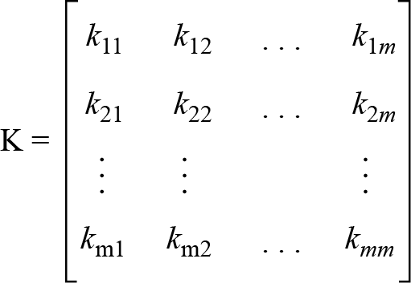
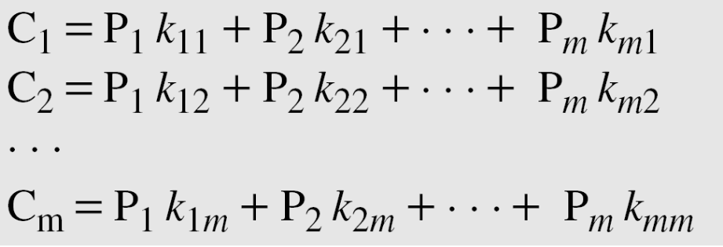

Hill Cipher
Figure 3.15 Key in the Hill cipher
Note
The key matrix in the Hill cipher needs to have a multiplicative inverse.
3.<number>

Slide 38
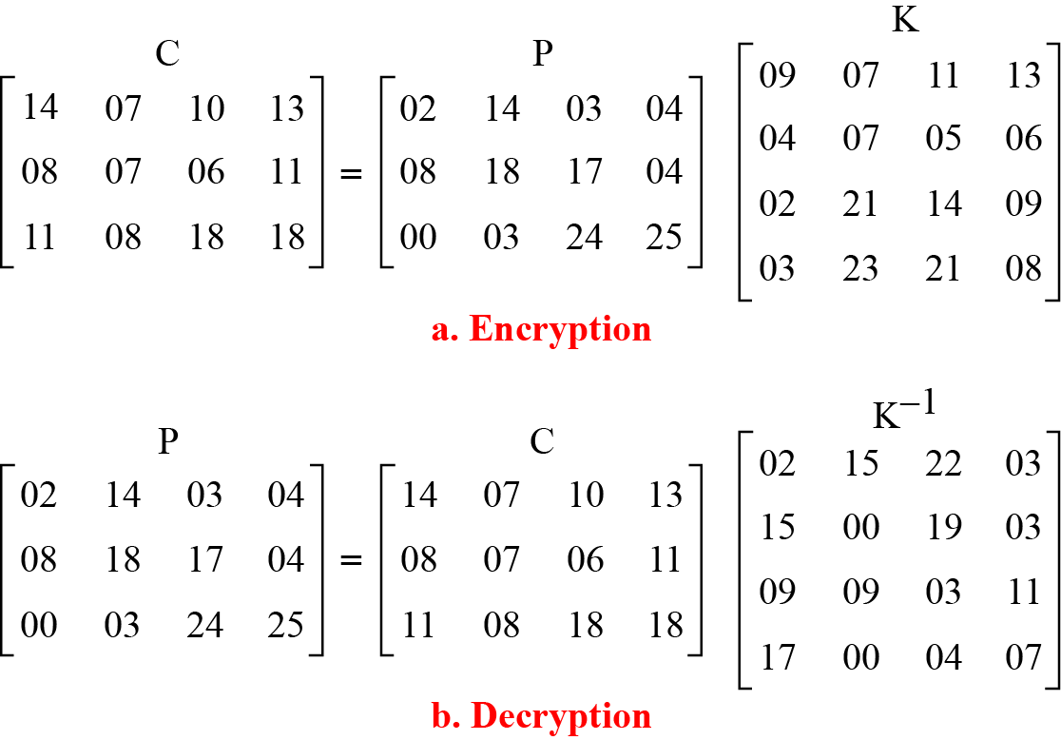
3.2.2 Continued
Example 3.20
For example, the plaintext “code is ready” can make a 3 × 4 matrix when adding extra bogus character “z” to the last block and removing the spaces. The ciphertext is “OHKNIHGKLISS”.
Figure 3.16 Example 3.20
3.<number>

Slide 39
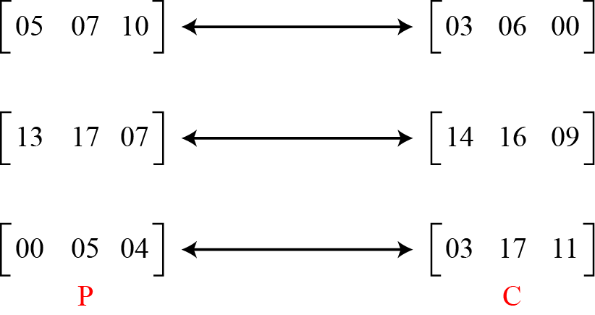
3.2.2 Continued
Example 3.21
Assume that Eve knows that m = 3. She has intercepted three plaintext/ciphertext pair blocks (not necessarily from the same message) as shown in Figure 3.17.
Figure 3.17 Example 3.21
3.<number>

Slide 40
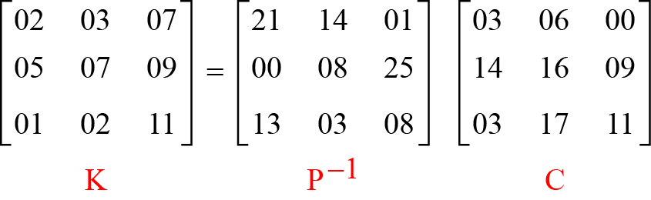
3.2.2 Continued
Example 3.21
(Continued)
She makes matrices P and C from these pairs. Because P is invertible, she inverts the P matrix and multiplies it by C to get the K matrix as shown in Figure 3.18.
Figure 3.18 Example 3.21
Now she has the key and can break any ciphertext encrypted with that key.
3.<number>

Slide 41
3-4 STREAM AND BLOCK CIPHERS
The literature divides the symmetric ciphers into two broad categories: stream ciphers and block ciphers. Although the definitions are normally applied to modern ciphers, this categorization also applies to traditional ciphers.
Topics discussed in this section:
3.4.1 Stream Ciphers
3.4.2 Block Ciphers
3.4.3 Combination
3.<number>

Slide 42
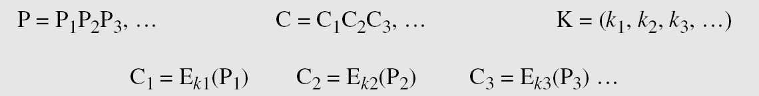
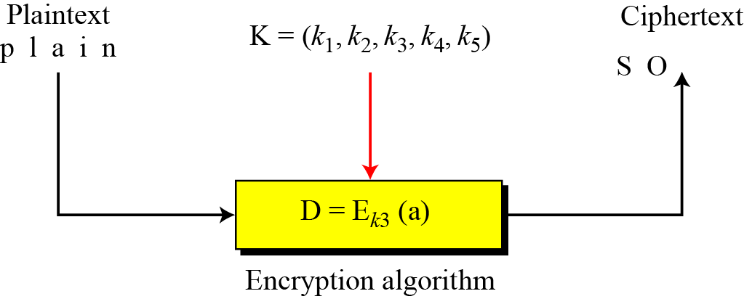
3.4.1 Stream Ciphers
Call the plaintext stream P, the ciphertext stream C, and the key stream K.
Figure 3.26 Stream cipher
3.<number>

Slide 43
3.4.1 Continued
Example 3.30
Additive ciphers can be categorized as stream ciphers in which the key stream is the repeated value of the key. In other words, the key stream is considered as a predetermined stream of keys or
K = (k, k, …, k). In this cipher, however, each character in the ciphertext depends only on the corresponding character in the plaintext, because the key stream is generated independently.
Example 3.31
The monoalphabetic substitution ciphers discussed in this chapter are also stream ciphers. However, each value of the key stream in this case is the mapping of the current plaintext character to the corresponding ciphertext character in the mapping table.
3.<number>

Slide 44
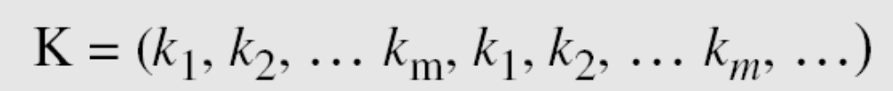
3.4.1 Continued
Example 3.32
Vigenere ciphers are also stream ciphers according to the definition. In this case, the key stream is a repetition of m values, where m is the size of the keyword. In other words,
Example 3.33
We can establish a criterion to divide stream ciphers based on their key streams. We can say that a stream cipher is a monoalphabetic cipher if the value of k_{i} does not depend on the position of the plaintext character in the plaintext stream; otherwise, the cipher is polyalphabetic.
3.<number>

Slide 45
3.4.1 Continued
Example 3.33
(Continued)
Additive ciphers are definitely monoalphabetic because k_{i} in the key stream is fixed; it does not depend on the position of the character in the plaintext.
Monoalphabetic substitution ciphers are monoalphabetic because k_{i} does not depend on the position of the corresponding character in the plaintext stream; it depends only on the value of the plaintext character.
Vigenere ciphers are polyalphabetic ciphers because k_{i} definitely depends on the position of the plaintext character. However, the dependency is cyclic. The key is the same for two characters m positions apart.
3.<number>

Slide 46
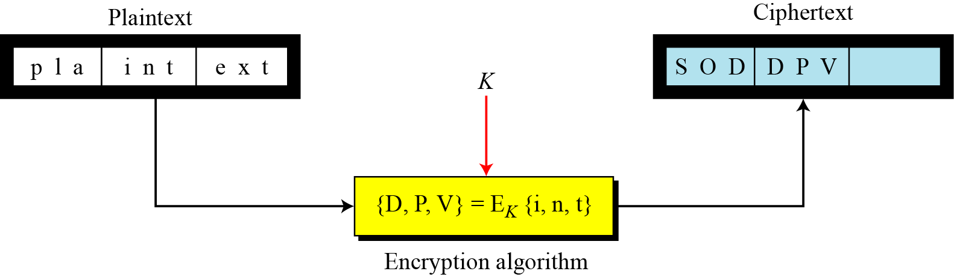
3.4.2 Stream Ciphers
In a block cipher, a group of plaintext symbols of size m (m > 1) are encrypted together creating a group of ciphertext of the same size. A single key is used to encrypt the whole block even if the key is made of multiple values. Figure 3.27 shows the concept of a block cipher.
Figure 3.27 Block cipher
3.<number>

Slide 47
3.4.2 Continued
Example 3.34
Playfair ciphers are block ciphers. The size of the block is m = 2. Two characters are encrypted together.
Example 3.35
Hill ciphers are block ciphers. A block of plaintext, of size 2 or more is encrypted together using a single key (a matrix). In these ciphers, the value of each character in the ciphertext depends on
all the values of the characters in the plaintext. Although the key is made of m × m values, it is considered as a single key.
Example 3.36
From the definition of the block cipher, it is clear that every block cipher is a polyalphabetic cipher because each character in a ciphertext block depends on all characters in the plaintext block.
3.<number>

Slide 48
3.4.3 Combination
In practice, blocks of plaintext are encrypted individually, but they use a stream of keys to encrypt the whole message block by block. In other words, the cipher is a block cipher when looking at the individual blocks, but it is a stream cipher when looking at the whole message considering each block as a single unit.
3.<number>

